Slide 1

Semi-automatic Generation of R2RML Mappings
Vânia Maria P. Vidal
Marco A. Casanova
Luís Eufrasio T. Neto

Slide 2
R2RML (RDB to RDF Mapping Language)
W3C recommendation language for expressing customized mappings from RDBs to RDF datasets

Slide 3
R2RML
R2RML refers to logical tables
A logical table can be:
  a base table;
  a view; or
  a valid SQL Query (called “R2RML view”)

Slide 4
Mapping Process
A 3-Steps Process for RDB-to-RDF mapping creation

Slide 5
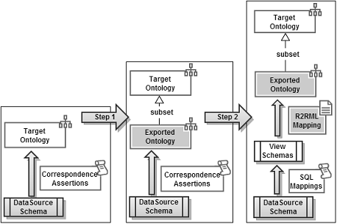
Process Steps

Slide 6
Correspondence Assertions
CA specify the mapping: Relational Schema -> Target Ontology Schema
Three types:
  Class Correspondence Assertion (CCA)
  Object Property Correspondence Assertion (OCA)
  Datatype Property Correspondence Assertion (DCA)

Slide 7
Class Correspondence Assertion
Matches a class and a relation schema
An expression of one of the following forms:
  Ψ: C ≡ R[A1,...,An]
  Ψ: C ≡ R[A1,...,An]σ
Example:
  CCA1: foaf:Person ≡ Persons_Rel[perID]

Slide 8
Object Property Correspondence Assertion
Matches an object property with paths (list of foreign keys) of a relation schema
An expression of one of the following forms:
  Ψ: O ≡ R / ϕ
  Ψ: O ≡ R / NULL
Example:
  OCA1: conf:hasAffiliation ≡ Persons_Rel / [hasPerson, hasOrganization]

Slide 9
Datatype Property Correspondence Assertion
Matches a datatype property with attributes or paths of a relation schema
An expression of one of the following forms:
  Ψ: P ≡ R / A
  Ψ: P ≡ R / {A1,...,An}
  Ψ: P ≡ R / ϕ / B
  Ψ: P ≡ R / ϕ / {B1,...,Bn}
Example:
  DCA1: foaf:name ≡ Persons_Rel / firstName

Slide 10
Running Example

Slide 11
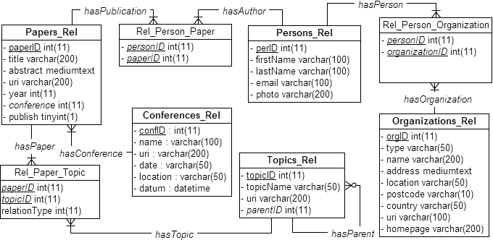
Source Relational Database

Slide 12
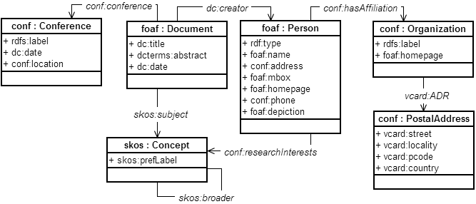
Target Ontology

Slide 13
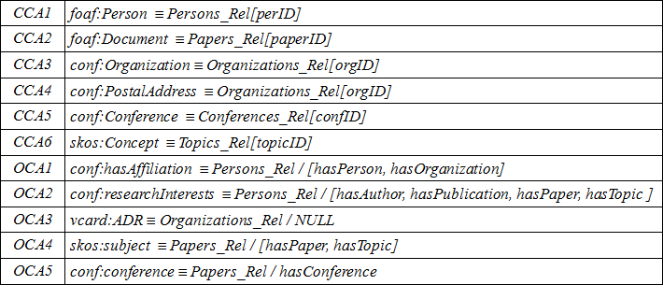
Correspondence Assertions

Slide 14
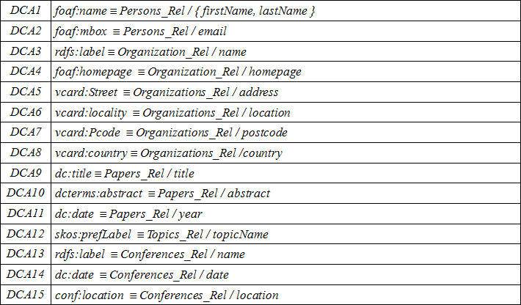
Correspondence Assertions

Slide 15
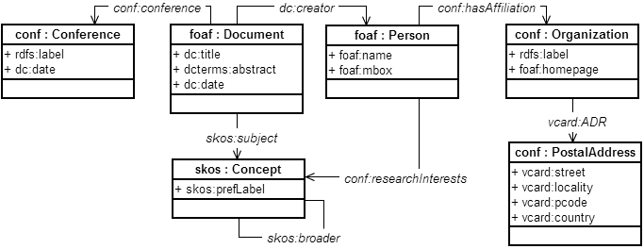
Exported Ontology

Slide 16
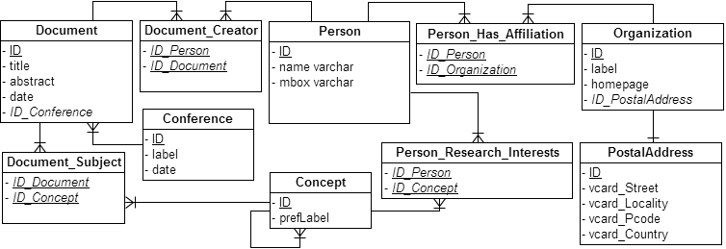
Views Schema

Slide 17

RBA (R2RML By Assertions)
A tool that simplifies the task of generating and deploying customized R2RML mappings

Slide 18
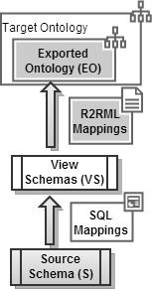
R2RML By Assertions
3-Level Architecture:
  EO: models the RDF View exported
  VS: set of Relational Views
    Definition of SQL mappings
    Definition of R2RML mappings
  S: source database schema

Slide 19
R2RML By Assertions
Main Components:
  GUI: configure/load the schemas and definition of correspondence assertions
  GEO: Generate Exported Ontology
  GVS: Generate Views Schema
  GM-R2RML: Generate Mapping R2RML

Slide 20
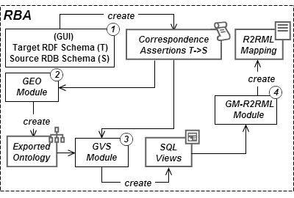
R2RML By Assertions
Main Components:

Slide 21
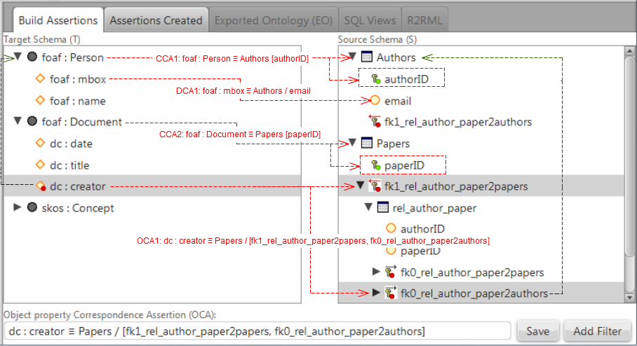
R2RML By Assertions
Building Assertions:

Slide 22
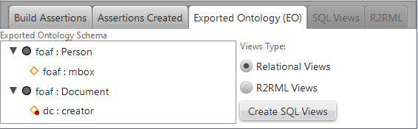
R2RML By Assertions
Exported Ontology:

Slide 23
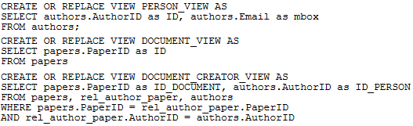
R2RML By Assertions
SQL Views:

Slide 24
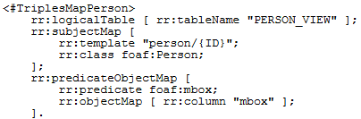
R2RML By Assertions
R2RML Mapping:

Slide 25

R2RML By Assertions
R2RML Mapping:

Slide 26
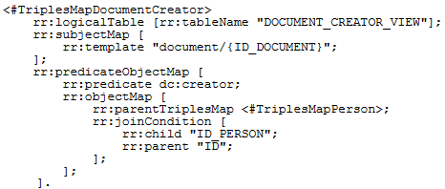
R2RML By Assertions
R2RML Mapping:

